Slide 1
Continuous Delivery with Zero Downtime. Made Real by DevOps

Slide 2
Agenda
Today we will take you through the following:
What Is Continuous Delivery
What Is Devops
How Devops Revolutionized Continuous Delivery
Traditional Vs Devops Approach
Companies Using Devops

Slide 3
What Is Continuous Delivery

Slide 4

What is Continuous Delivery
“ Continuous delivery is a software development strategy that optimizes your delivery process to get high-quality, valuable software delivered as quickly as possible “

Slide 5
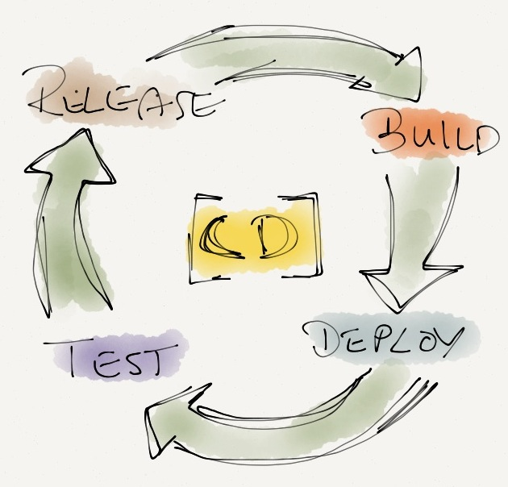
Continuous Delivery Cycle

Slide 6
What is DevOps

Slide 7
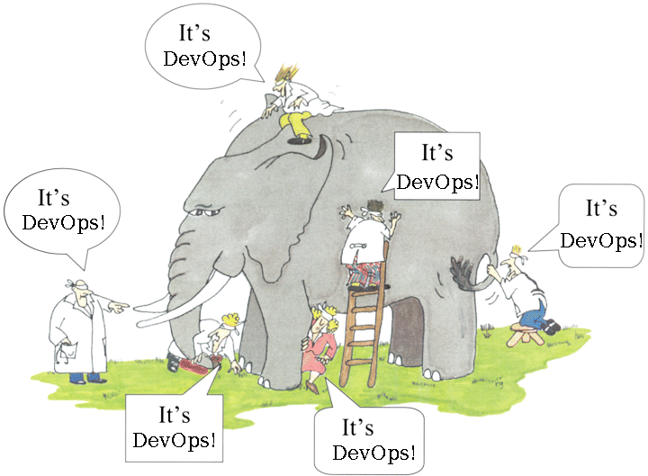
What is DevOps

Slide 8
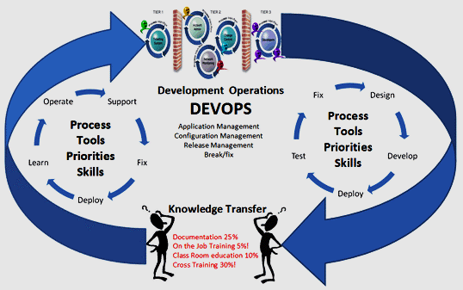
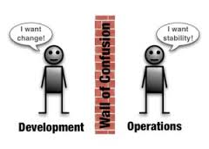
Before DevOps

Slide 9
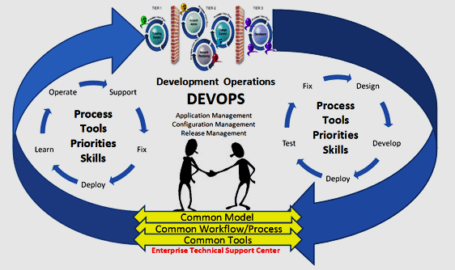
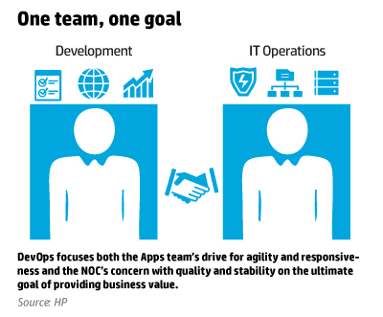
DevOps

Slide 10
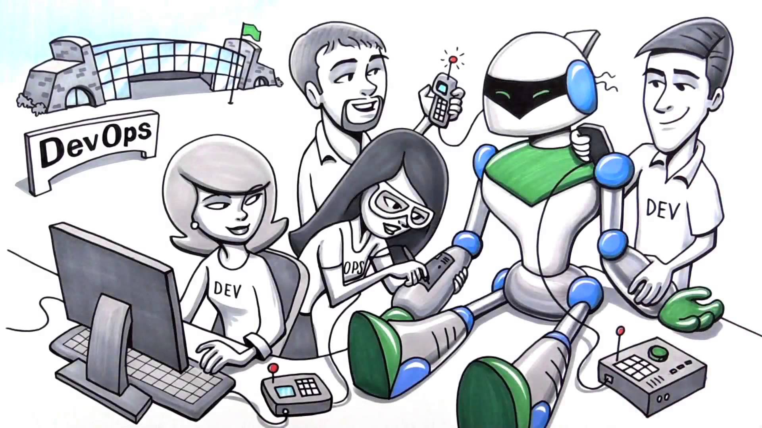
DevOps Now
Practice of operations and development engineers participating together in the entire service lifecycle, from design through the development process to production support.

Slide 11
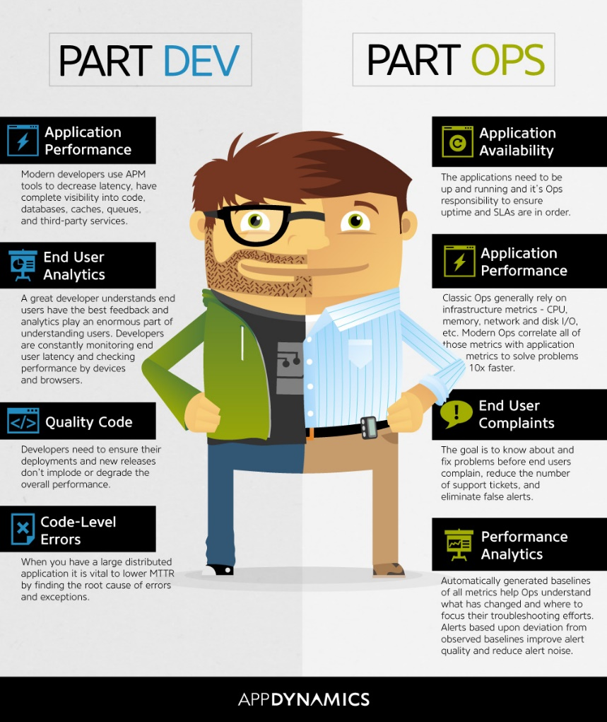
Devops Responsibilities

Slide 12
How Devops Revolutionized
Continuous Delivery And Continuous Integration

Slide 13
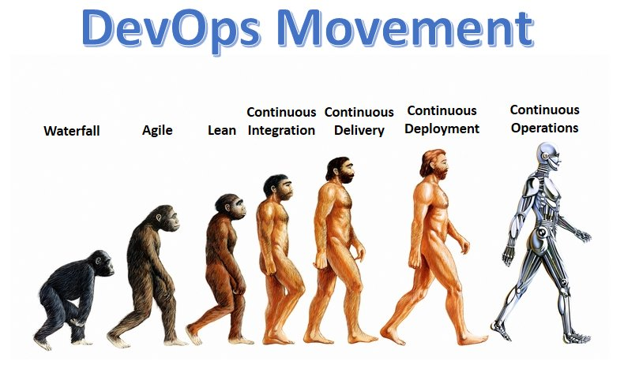

Slide 14
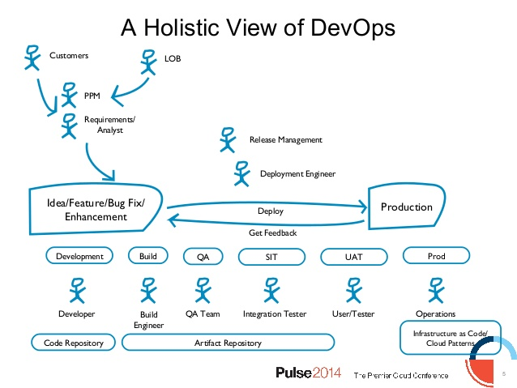

DevOps Cycle

Slide 15
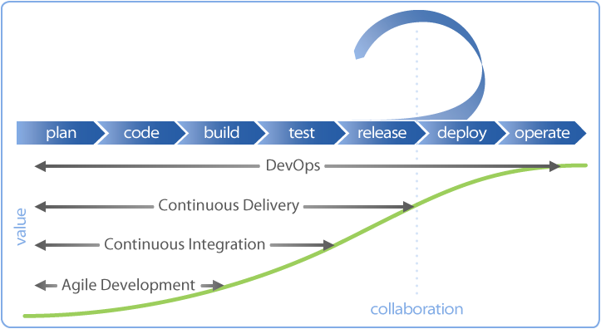

Slide 16
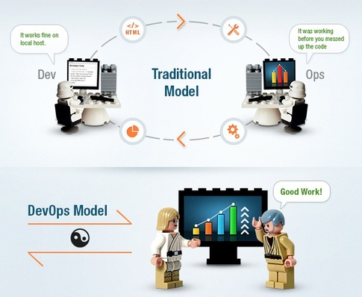
Traditional Vs DevOps Approach

Slide 17






Companies Doing DevOps

Slide 18

DevOps Application
Rancher Labs hopes to help DevOps teams rope in container management
Rancher Labs, is hoping to help organizations address the scalability with a new open-source Docker platform
It’s designed to be a full set of tools to help DevOps teams manage Docker containers in production

Slide 19
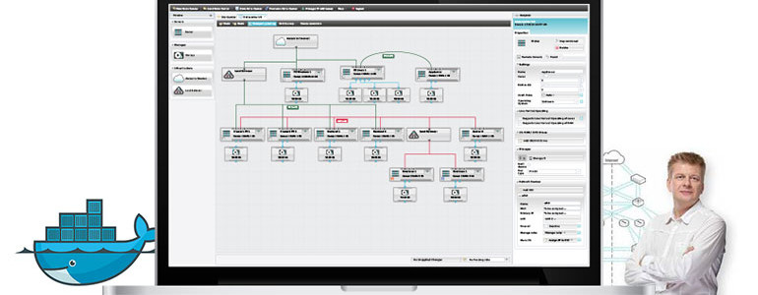
DevOps Application
ProfitBricks shakes things up with new Docker hosting platform
Docker has been taking the DevOps world by storm since its widespread introduction
Ensure that resources are automatically managed to meet the demands of the Docker containers running on it

Slide 20

DevOps Application
GE Capital Releases Mobile App Twice Weekly, Automating Compliance at Velocity, Thanks to DevOps
According to GE , his team leads the charge in driving :
(A) the DevOps cultural transformation throughout IT,
(B) the adoption and expansion of DevOps tooling, and
(C) the change in governing structures in order to operate at a much higher velocity while continuing to meet regulatory requirements.

Slide 21
Demo

Slide 23
Survey

